Slide 1

Skylytics – An AI Powered Flight Delay Prediction System
FYP Proposal Defense – (BSCS-F25-026)
03-134222-003 | Abdul Mutlib Ali
03-134222-007 | Abuzar Rashid
03-134222-039 | Kumail Ahmed
Supervisor: Dr. Nadeem Sarwar

Slide 2
CLO Mapping
CLO | PLO | Description | Specified Aspects
CLO1 | PLO3:Problem Analysis | Analyze the given problem to propose a computing-based solution. | Identified persistent flight delays, analyzed causes (weather, congestion, crew, aircraft), proposed AI-powered predictive system
CLO2 | PLO4:Design and Development of Solutions | Design and develop computing solutions to complex computing problems. | Designed hybrid ML + DL models (XGBoost + LSTM/Transformer) with explainable AI for flight delay prediction
CLO3 | PLO5:Modern Tool Usage | Demonstrate the ability to use modern tools to solve the given problem. | Used Python ML libraries, FastAPI, Docker, Next.js, Tailwind, SwiftUI, PostgreSQL, Redis, AWS cloud deployment
CLO4 | PLO6:Individual and Team Work | Demonstrate the ability to work effectively as an individual and a team member. | Collaborated as team of three, divided tasks into ML, backend, frontend, ensured integration and testing
CLO5 | PLO10:Life Long Learning | Understand the significance of broader aspects of innovation, potential legal implications, and development. | Explored explainable AI (SHAP/LIME), cloud deployment, live API integration, evaluated ethical issues of AI predictions
CLO6 | PLO7:Communication | Demonstrate effective skills in verbal and written communication during presentations, discussions, and reports. | Delivered presentations, prepared proposal and report, documented system design and methodology clearly

Slide 3

Abstract
Persistent flight delays cause major financial losses for airlines and frustration for passengers
Current solultions lack real-time and transparent predictions
Skylytics introduces a hybrid ensemble of XGBoost, LSTM, and Transformer models
Integrated with SHAP explainability for stakeholder trust
Delivered through a web dashboard and iOS app for accessible, real-time insights

Slide 4
Objectives
To collect and preprocess aviation datasets
To develop a hybrid machine learning and deep learning model
To design backend API services using FastAPI and Docker
To implement a scalable database system with PostgreSQL and Redis
To build a web application with prediction meter and analytics
To develop an iOS app with real-time features aligned to the web platform

Slide 5
Novelty
Hybrid Ensemble: Combines XGBoost, LSTM, and Transformer models
Explainable AI: SHAP-based feature attribution for trust and clarity
Interactive Web Application: Real-time predictions, heatmaps, and what-if analysis
Cross-Platform Access: Unified experience on web and iOS
Scalable Cloud Deployment: Reliable, production-ready system

Slide 6
Deliverable and Beneficiaries
Following are the deliverables
Hybrid ML and DL prediction model
Backend API services using FastAPI and Docker
Scalable PostgreSQL and Redis database system
Comprehensive website with prediction meter
Interactive what-if analysis and delay heatmaps
IOS application replicating website functionalities
Following are the beneficiaries
Airline managers, staff, and passengers reliable predictions, smarter decisions, improved travel experience
Airlines, airports, and regulators reduced costs, optimized operations, enhanced oversight

Slide 7
Scope
PRIMARY
Flight delay prediction using hybrid ML + DL models
Integration of flight, weather, and airport datasets
Explainable predictions with SHAP for transparency
Scalable deployment with FastAPI, Docker, PostgreSQL, Redis
Multi-platform access through website and iOS app
Optional
Real-time aviation APIs integration (FlightAware, FlightRadar24)
3D flight visualization for enhanced interactivity

Slide 8
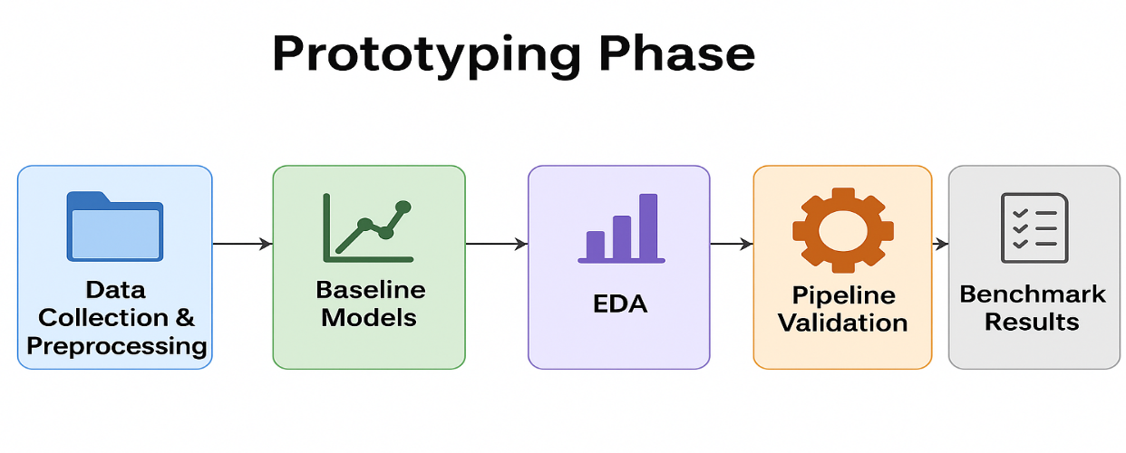
Methodology – (1/4) Prototyping Phase
Data Collection & Preprocessing : Gather flight datasets, clean & standardize
Baseline Models : Apply simple ML models for initial benchmarks
EDA : Explore delay patterns and key influencing factors
Pipeline Validation : Test end-to-end data flow with small experiments
Benchmark Results : Record baseline accuracy for later comparison

Slide 9
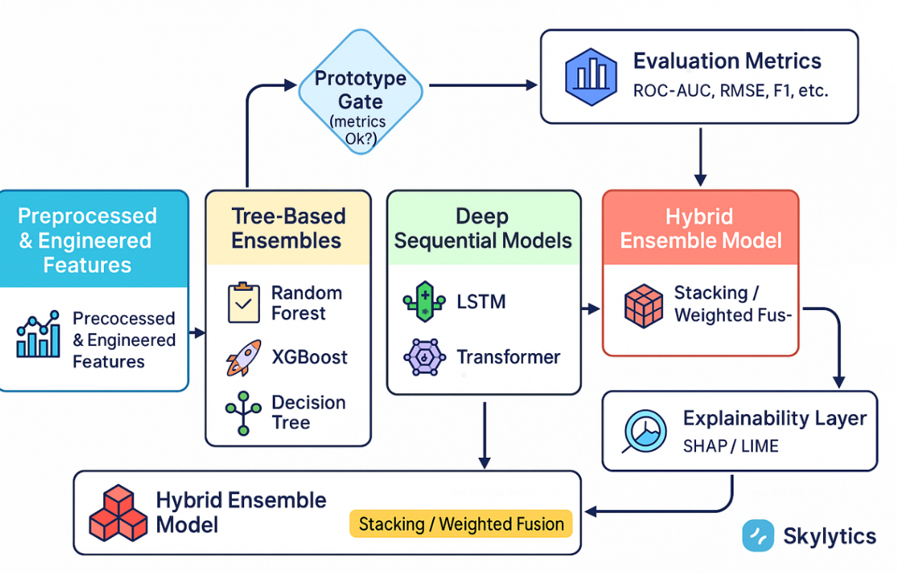
Methodology – (2/4) Advanced Model Development Phase
Feature Engineering: Merge flight, weather, and route datasets into enriched inputs
Tree-Based Models: Train Decision Tree, Random Forest, and XGBoost to capture non-linear patterns
Deep Models: Use LSTM and Transformer to model temporal dependencies
Hybrid Ensemble: Combine outputs with stacking/weighted fusion for robust predictions
Evaluation & Explainability: Validate with F1/ROC-AUC; interpret predictions using SHAP

Slide 10
Methodology – (3/4) Evaluation, Explainability & Deployment
Multi-metric evaluation: Use precision, recall, F1-score, ROC-AUC (etc.) to evaluate model performance on imbalance, plus error analysis on mispredictions
Explainable AI: Apply SHAP (Shapley values) and LIME(optional) to each prediction for feature attribution, improving transparency and stakeholder trust
Realtime inference: Expose the trained model via a FastAPI RESTful backend, enabling real-time prediction queries for external applications
Scalable deployment: Containerize the API using Docker for portability; utilize Kubernetes (optional) for scaling to high traffic
Performance & monitoring: Employ Redis caching to speed up frequent queries and implement monitoring for data drift or anomalies to maintain reliability

Slide 11
Methodology – (4/4) User Interfaces Development
Web Application (Next.js + Tailwind): Full-featured platform for managers with prediction meter, delay heatmaps, what-if analysis, and SHAP explanations
Interactive Analytics: Visual tools for scenario testing, decision support, and transparent model insights
Unified Backend: Both web and iOS connect to FastAPI API, ensuring consistent results across platforms
Collaboration & UX: Website includes collaboration tools with a responsive and user-friendly design for wider adoption

Slide 12
Resources and Risks (1/2)
Team Capabilities
Abdul Mutlib Ali – ML and data engineering
Abuzar Rashid – Web, databases and API Integration
Kumail Ahmed – Documentation and iOS App
Hardware & Software
Standard laptops with cloud support
Python stack: Pandas, scikit-learn, XGBoost, PyTorch
FastAPI, Docker, PostgreSQL, Redis
Next.js, Tailwind, SwiftUI
Data sources: BTS, Kaggle, Meteostat, OpenFlights

Slide 13
Resources and Risks (2/2)
Budget
Apple Developer Account – 99 USD yearly
AWS EC2 and RDS – 10–15 USD monthly
Total estimated under PKR 90,000
Key Risks & Mitigations
Risks hindering the proposed solution
Data or API limits: Usage caps and downtime → caching, fallback to historical datasets
Model uncertainty: Flight delays unpredictable → hybrid models, SHAP explanations for trust
Compute constraints: Deep models need high power → cloud training with AWS/Colab support
Integration complexity: Multi-platform system → API-first modular design with staged testing
Timeline slippage: Risk of project delays → buffer weeks added to milestones
Security & compliance: Sensitive aviation data → access control, secure key vaults, HTTPS

Slide 14
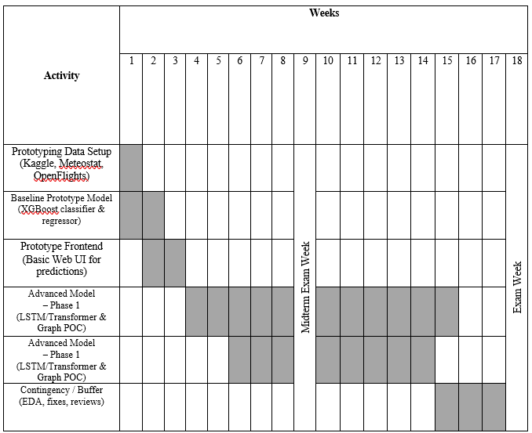
Gantt Chart [7th Semester]
Semester 7 - Fall 2025

Slide 15
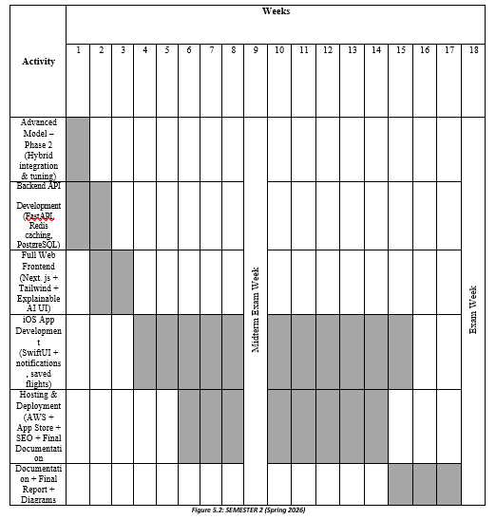
Gantt Chart [8th Semester]
Semester 8 - Spring 2026

Slide 16
Skylytics – An AI Powered Flight Delay Prediction System
Thanks
Please feel free to:
- Ask any further details
- Advise any improvements
FYP Proposal Defense – (BSCS -F25-026)
03-134222-003 | Abdul Mutlib Ali
03-134222-007 | Abuzar Rashid
03-134222-039 | Kumail Ahmed

